Slide 1
Representative Bakeberg and Senator Pratt Meeting
PLSLWD Board Meeting
January 9, 2025

Slide 2
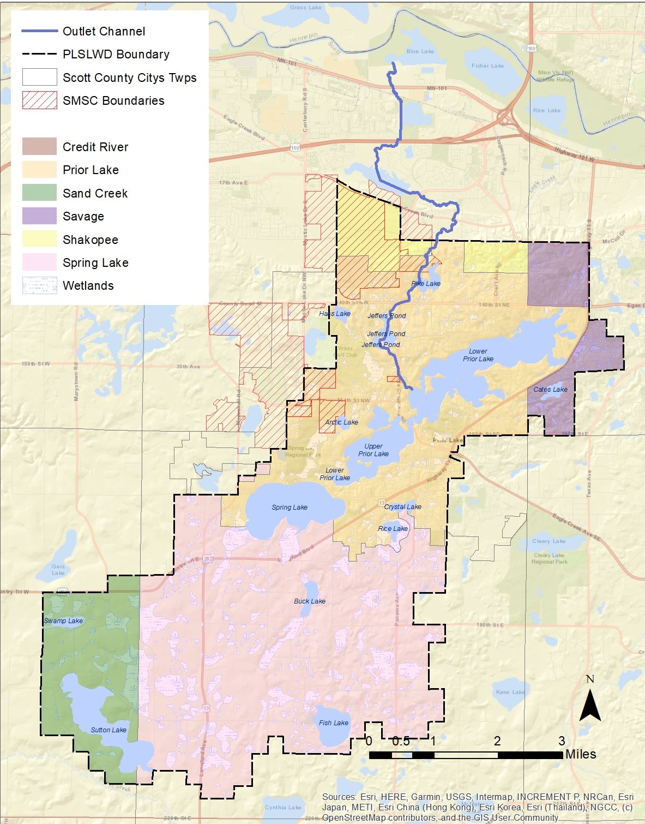
Watershed District
Established March 4, 1970
Specifically addressing rising lake levels on Prior Lake
Approximately 42 sq miles
Parts of Prior Lake, Shakopee, Savage, Sand Creek & Spring Lake Townships and Shakopee Mdewakanton Sioux Community

Slide 3
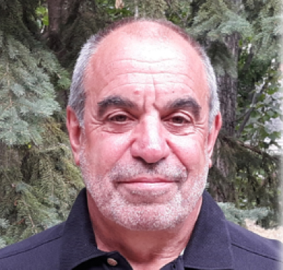
Watershed District
Activities Administered by 5-Person Board
Appointed by Scott County Commissioners
Includes Prior Lake Outlet Channel (PLOC – Memorandum Of Agreement)
Activities Carried out by 6 District Staff

Slide 4
Management Priorities
Water Quality
Emphasis on lakes with public access
Aquatic Invasive Species
Monitor existing and prevent spread
Reduce Flooding
Improve upstream storage capacity
Collaboration
Scott Soil & Water Conservation District
Citizens Advisory Committee (CAC)

Slide 5
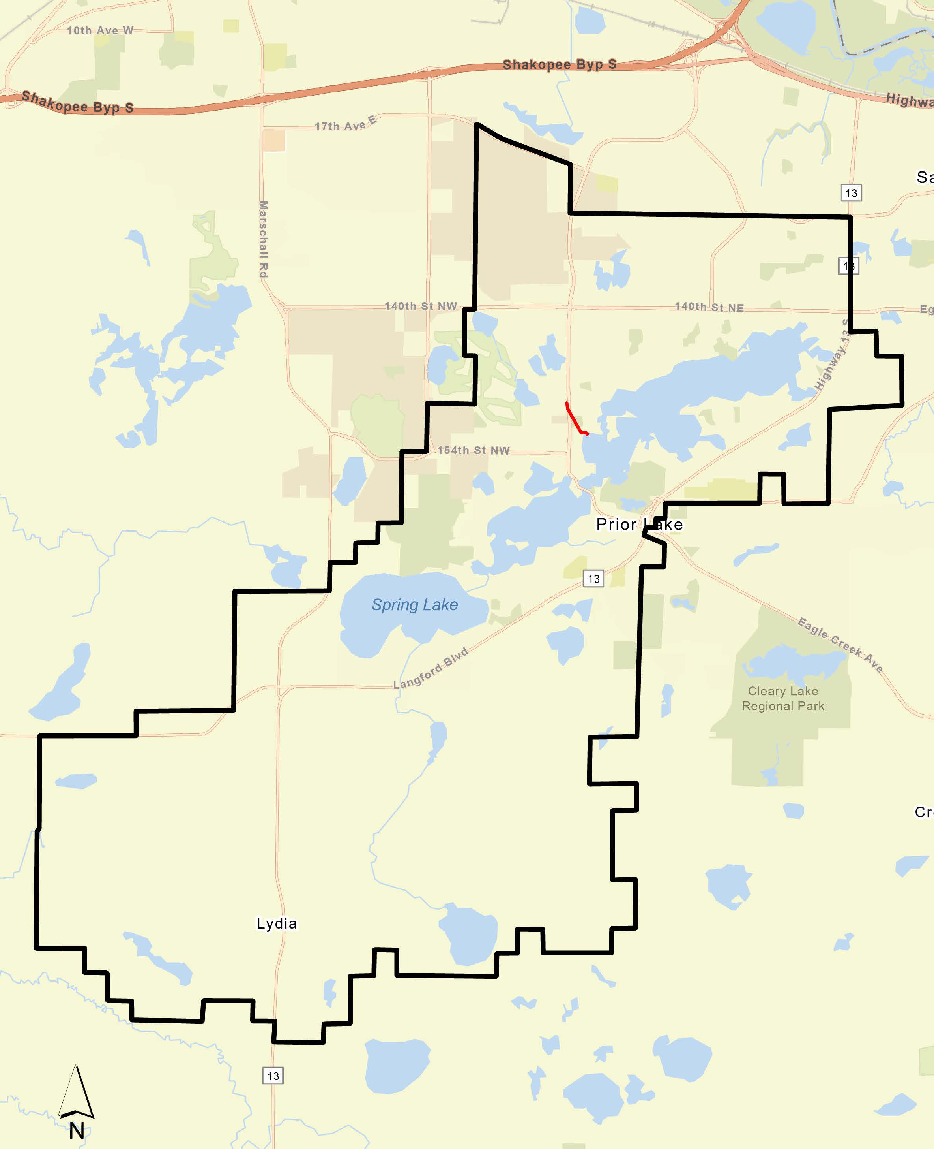
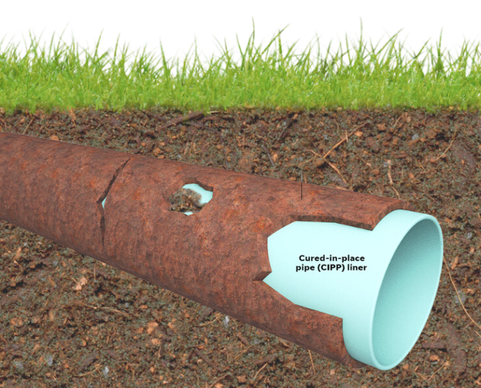
District Activities
Prior Lake Outlet: Pipe Lining

Slide 6
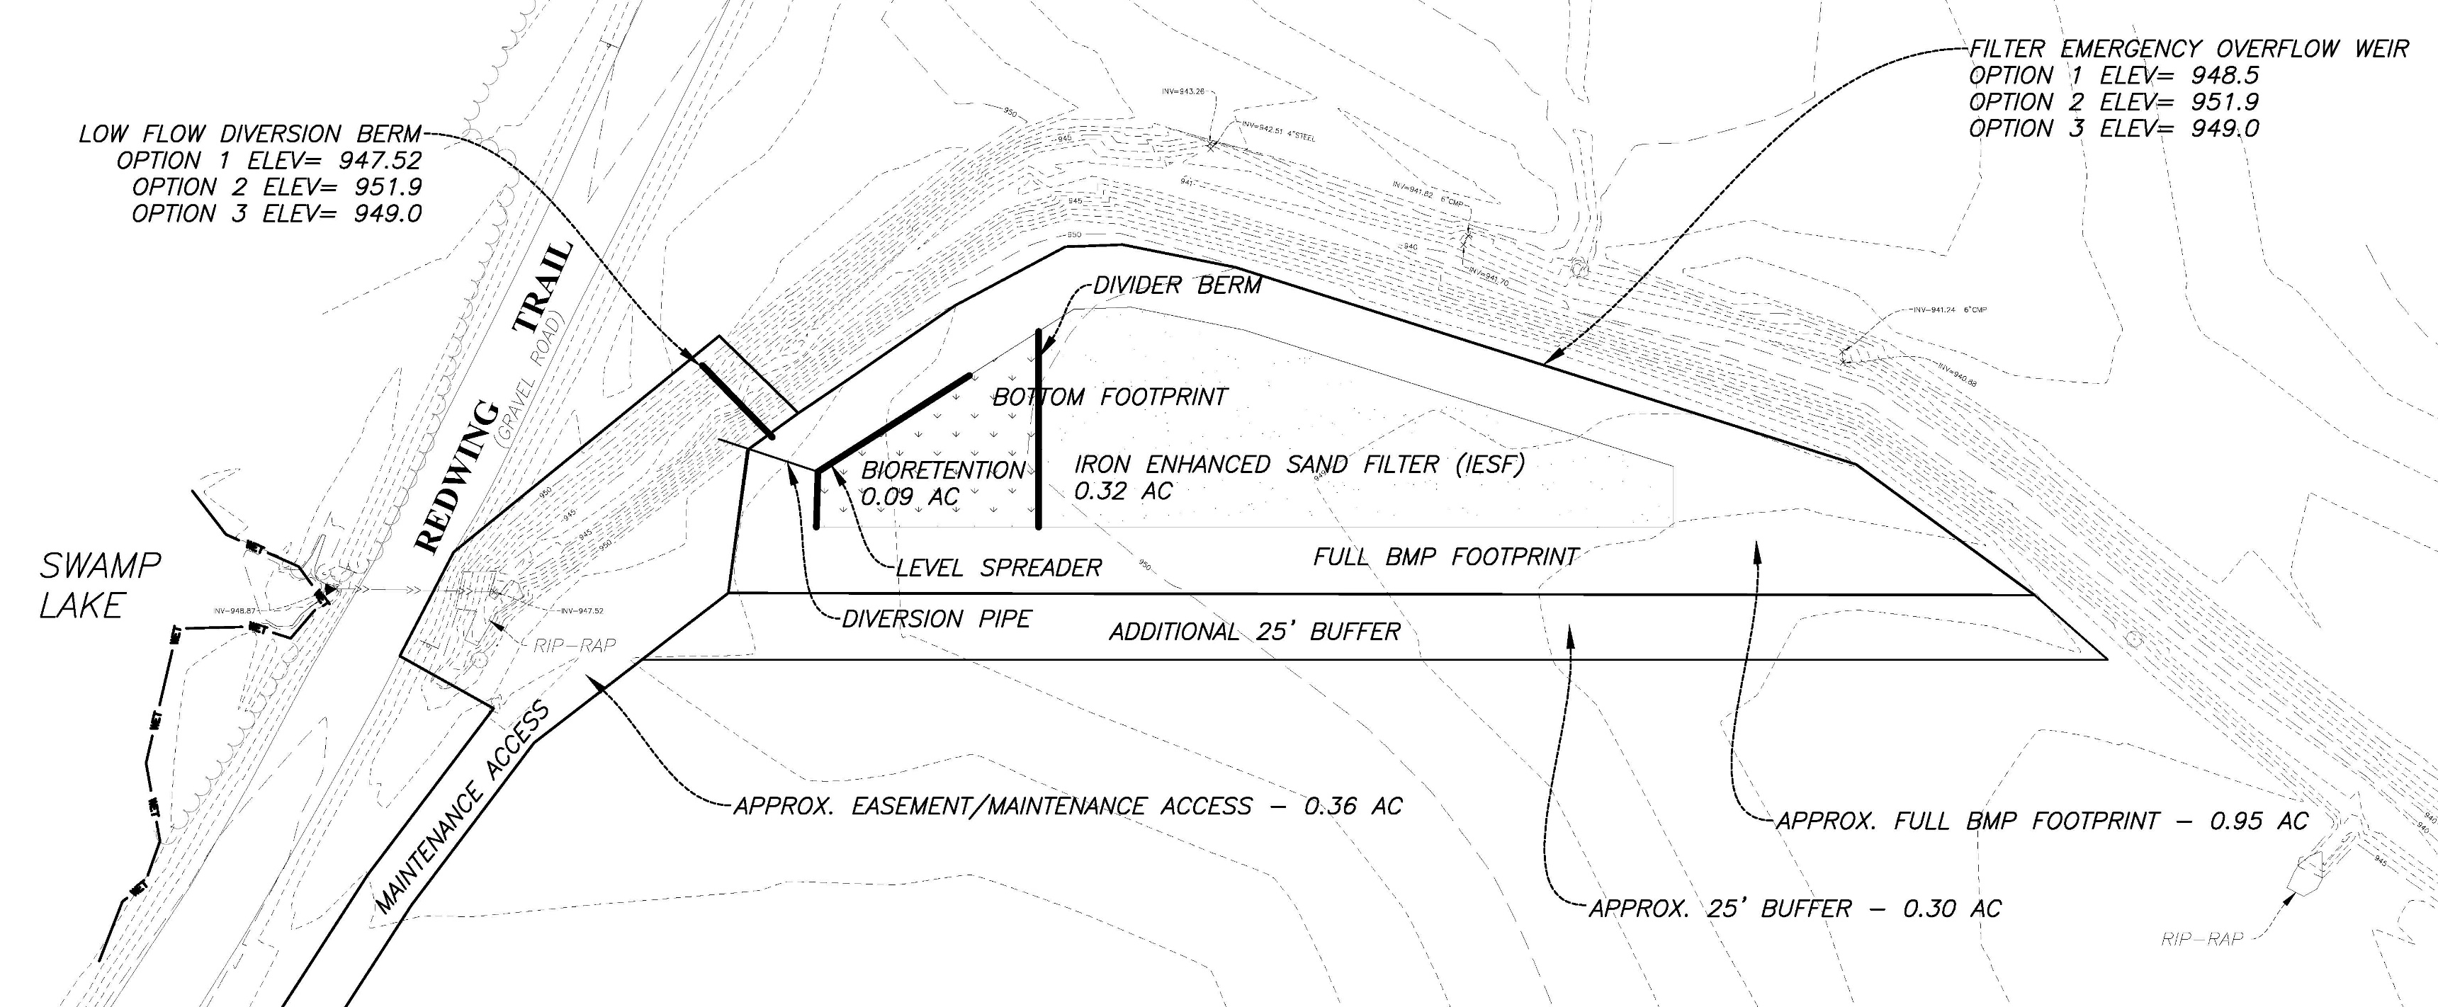
District Activities
Swamp Lake Iron Enhanced Sand Filter
Swamp Lake IESF

Slide 7
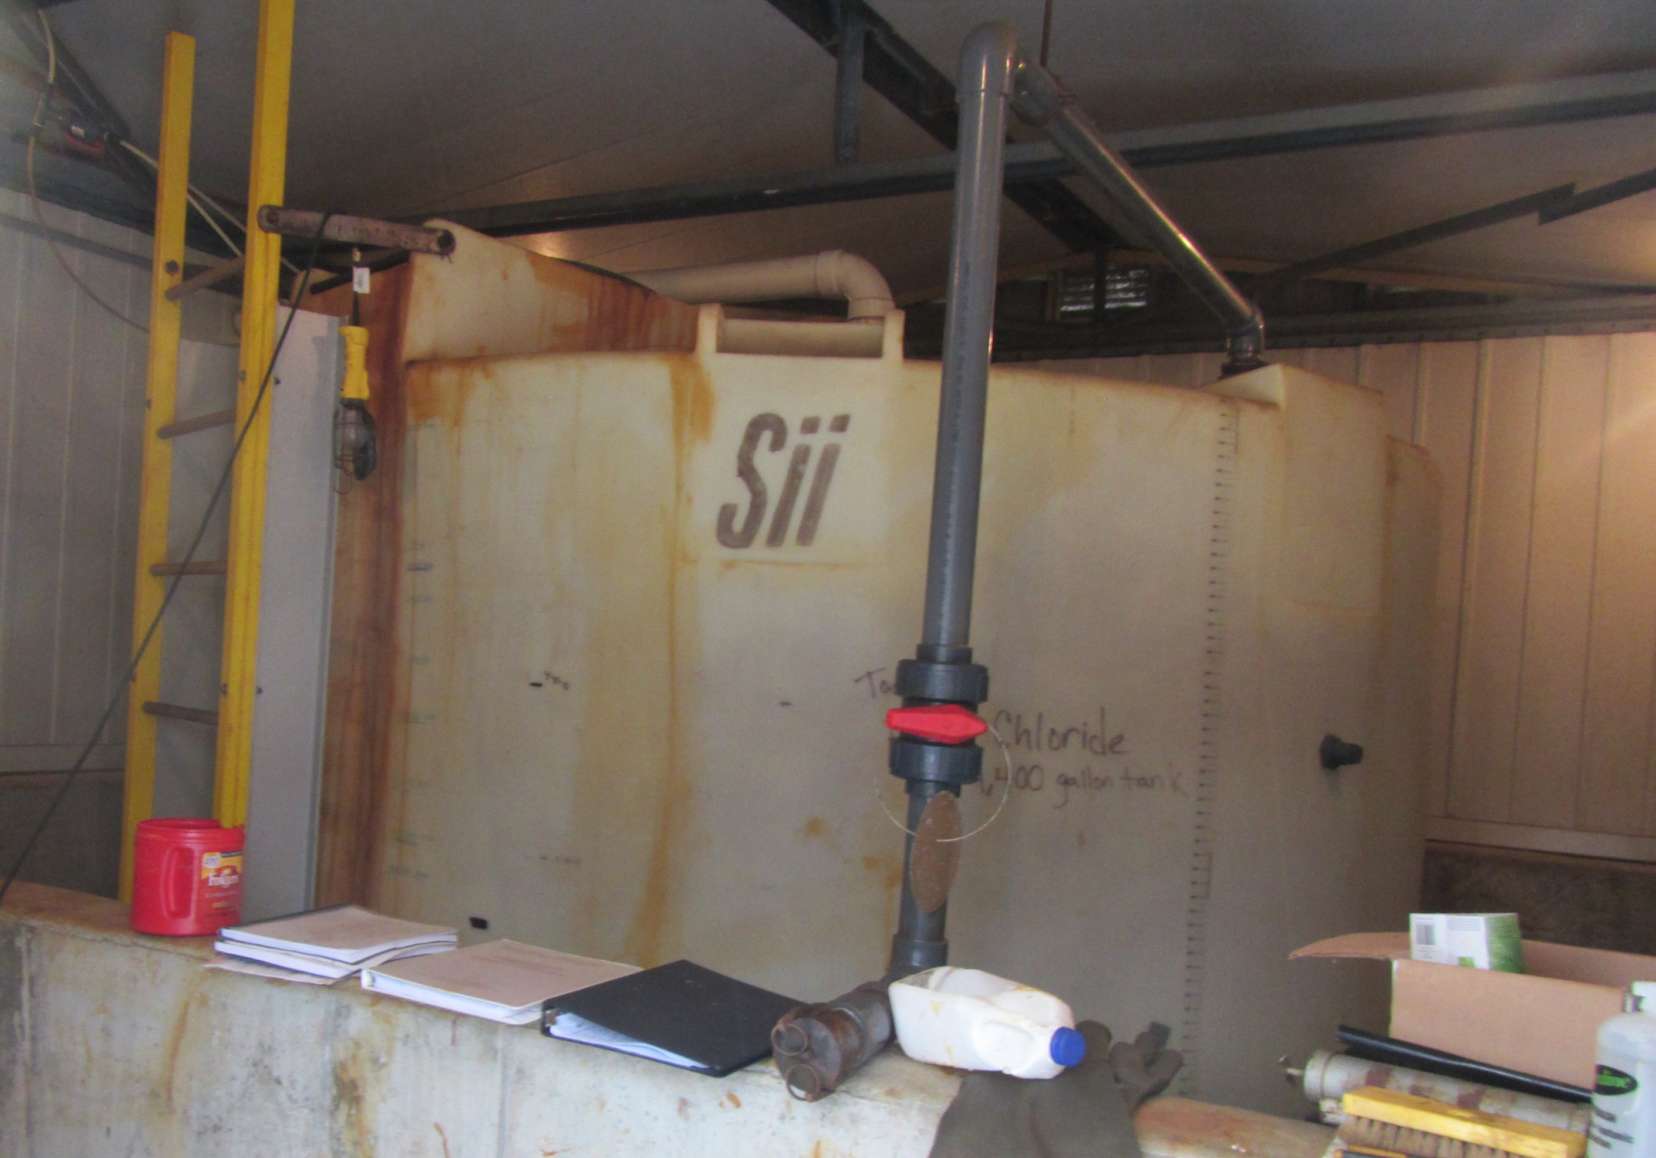
District Activities
Ferric Chloride Facility Update
FeCl Facility
Updates

Slide 8
District Activities
Upper Prior Lake: Carp Population Reduction
Carp
Reduction

Slide 9
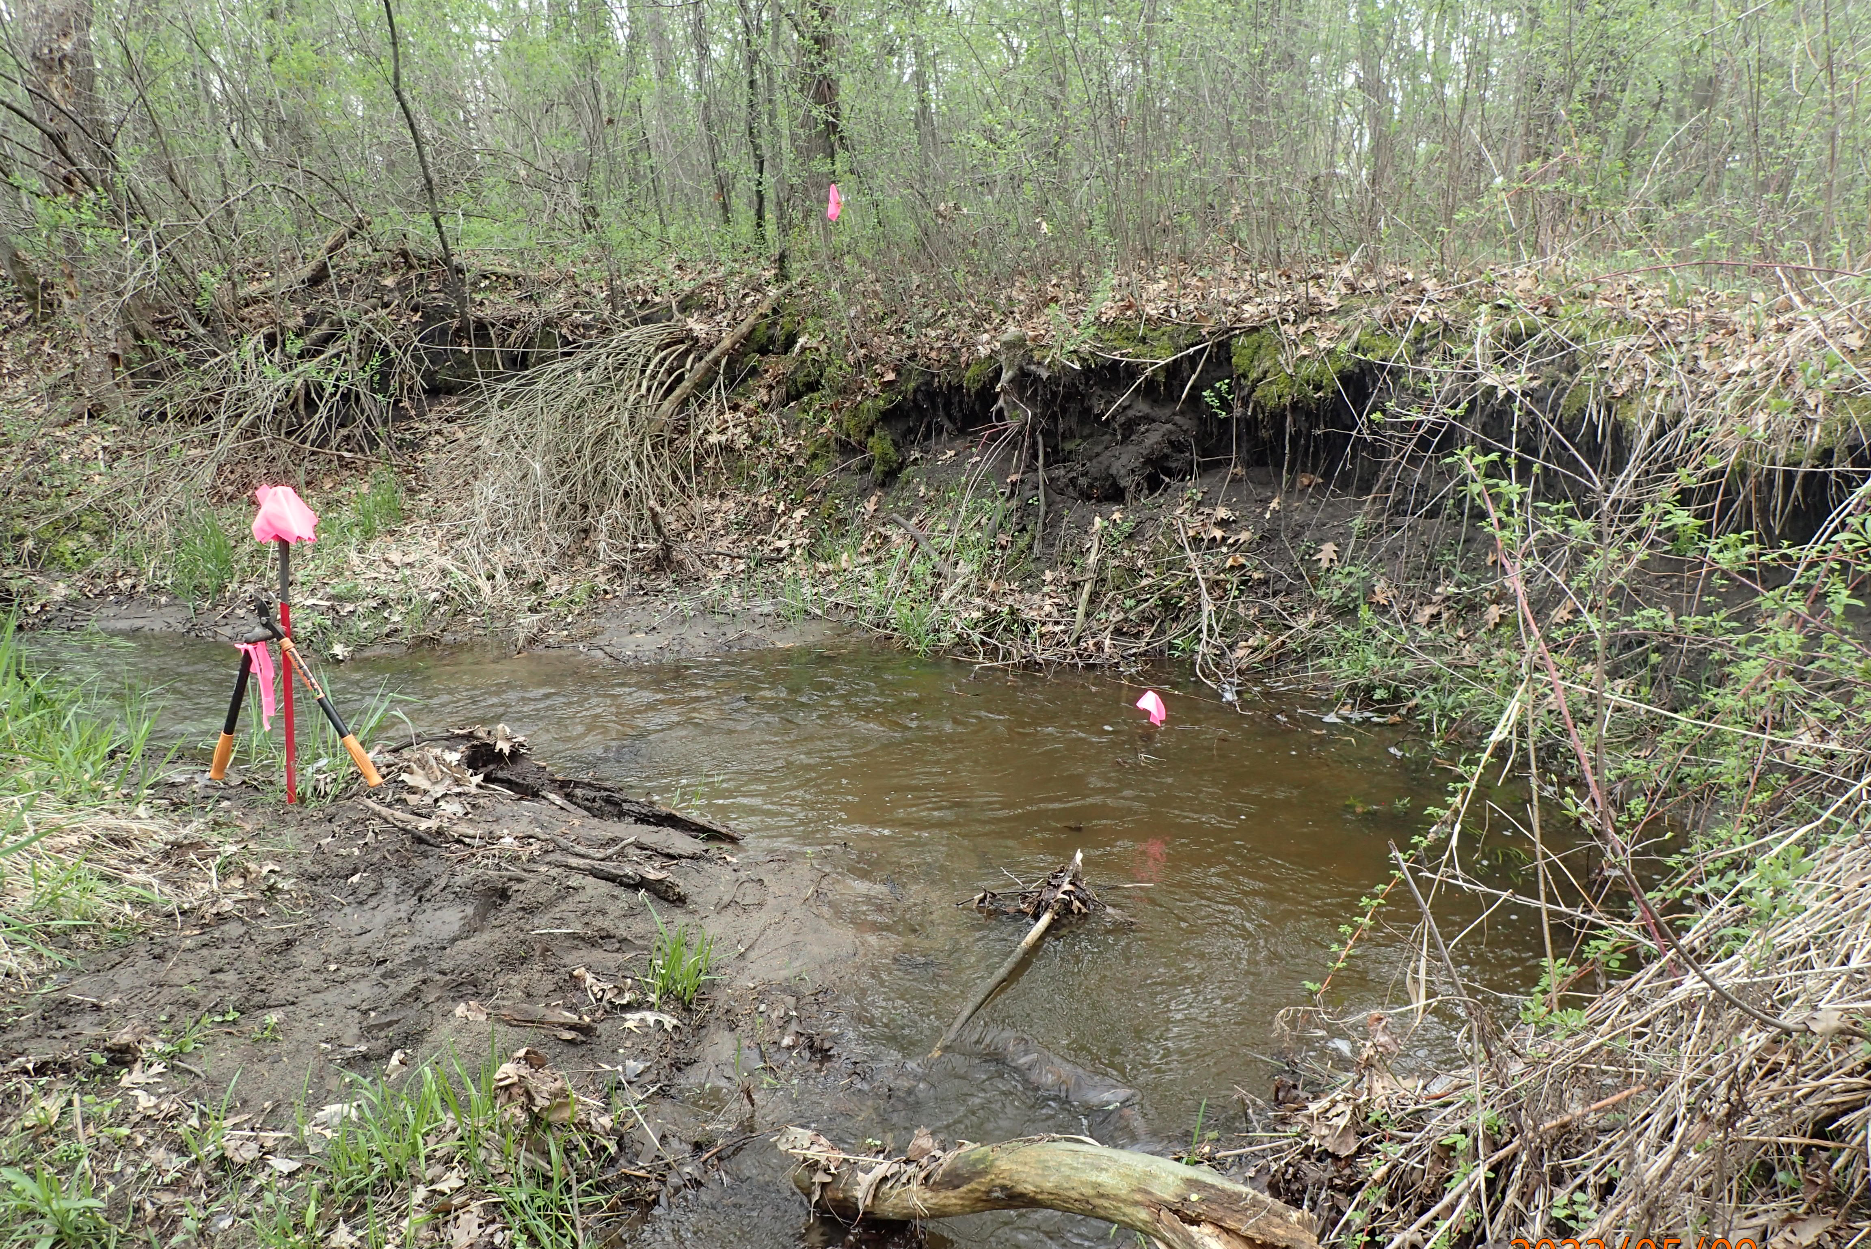
District Activities
Buck Stream Stabilization
Buck Stream
Stabilization

Slide 10
District Activities
Conservation Cover on Local Farms
2019- 2023:
872 acres certified as “Lake Friendly”
Funded over 2,400 acres of cover crops
Over 1,400 lbs of nutrients removed

Slide 11
2025 Legislative Priorities
SCALE
Reform Official Public Notices
Scott SWCD State Aid Funding
Minnesota Watersheds
Support 60-day permit review for Department of Natural Resources
Support developing regulatory approaches for reduce chloride contamination
Support Clean Water Land and Legacy Funding
Support streamlining the Flood Hazard Mitigation Program

Slide 12
Thank you!

